Slide 1



Project Documentation
Priya Jana
PROJECT RMS
Routine Management System
24 June 2022

Slide 2



Submitted By
Priya Jana
REG No. - 2019PBC01350
Under the Supervision of
MR. SANTOSH NANDI
(PROFESSOR)

Slide 3
INDEX
Introduction
Literature Review and Field Study
Project Features
System Design
Project Scope
Conclusion
References

Slide 4
INTRODUCTION
The Routine Management System (RMS) is a web-based application for educational institutions. It simplifies scheduling for batches, classes, and departments. RMS uses ASP.NET Core Web API and React, providing a user-friendly interface for managing teacher and student data, creating schedules, and generating reports.
Efficient Schedule Creation
Dynamic Adjustments
Automated Attendance and Grading
Centralized Information Management
Resource Distribution
Neil Freg
Business Owner

Slide 5
LITERATURE REVIEW AND FIELD STUDY
Objectives of the RMS Project
Issues with Manual Scheduling in Educational Institutions:
Prone to errors and inconsistencies
Inefficient and labor-intensive
Frequent scheduling conflicts
Lack of real-time updates
Inefficient resource management
Tedious attendance tracking
Lack of integration with grading systems
Automate the scheduling process
Provide real-time updates
Centralize resource management
Integrate attendance tracking with grading systems
Use AI-based algorithms for optimized schedule generation

Slide 6
PROJECT FEATURES
To address existing system limitation RMS offers the following key features:
01.
02.
03.
Management
Attandance Tracking
Reporting
Teacher and Student Management
Batch and Department Management
Schedule Creation and Editing
Real-Time Schedule Viewing
Teacher Attendance Tracking and Absence Notification
Student Attendance Tracking and Grading Integration
AI-Based Routine Generation
Notification
Export Functionality (Excel, PDF)
Dashboard and Reporting

Slide 7
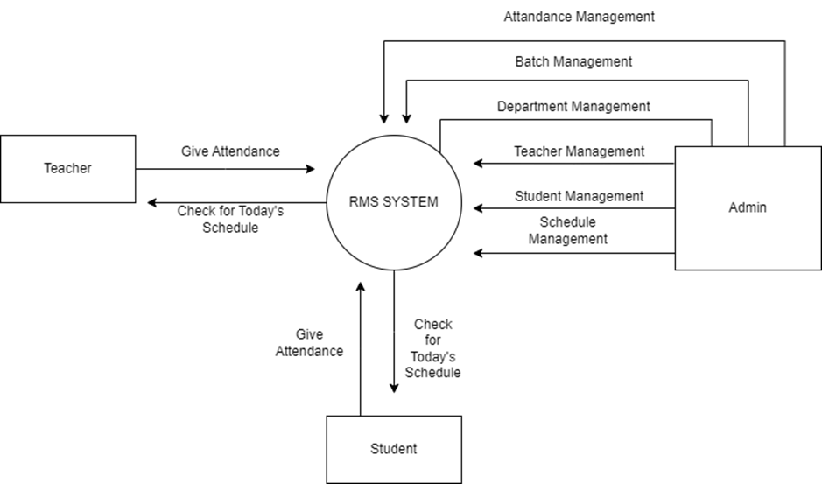
SYSTEM DESIGN
This project is developed using React for the frontend and Dotnet for the backend. SQLite serves as the database. The system incorporates a range of UML diagrams to depict the architecture and behavior, such as:
Top-Level Use Case Diagram
Sequence Diagrams
Class Diagram
Entity Relationship Diagram
These diagrams provide a detailed insight into the system's operations, connections, and data organization.
Fig 1 Top Level DFD

Slide 8

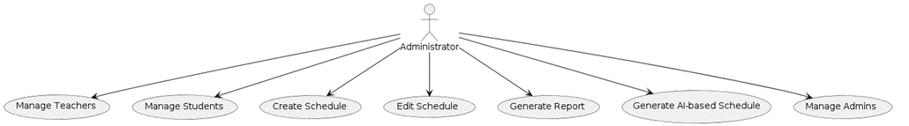
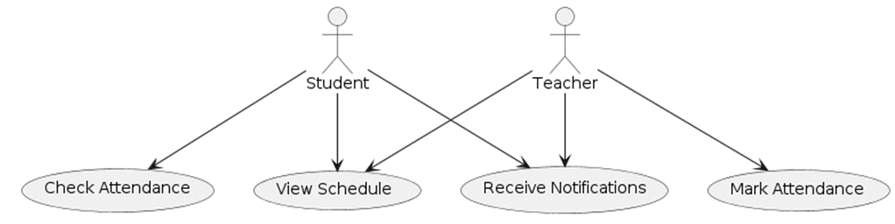
USE CASE DIAGRAM
Here is the use case diagram of this system where we have 3 types of user
Admin
Teacher
Student
Fig 2 Top-Level Use Case Diagram

Slide 9
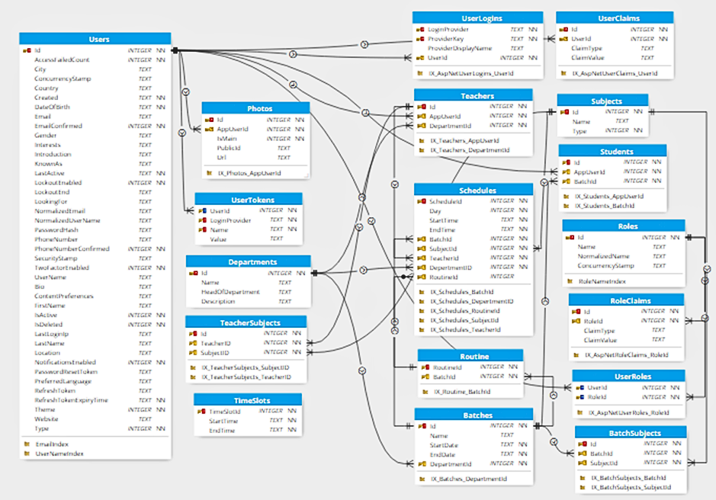
ENTITY RELATIONSHIP DIAGRAM
This depicts the relationship between data objects. The attribute of each data object noted in the entity-relationship diagram can be described using a data object description.
Fig 3 ER Diagram

Slide 10
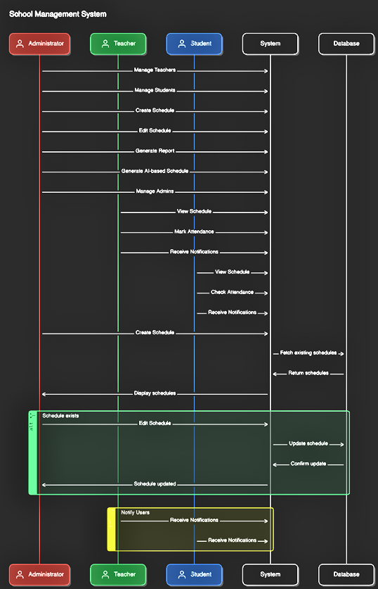
SEQUENCE DIAGRAM
A sequence diagram is an interaction diagram that emphasizes the time ordering of messages.
Fig 4 Sequence Diagram

Slide 11

ADVANTAGES
Efficiency and Accuracy
Flexibility and Transparency
Resource and Productivity
Automates routine tasks, reducing administrative workload
Minimizes errors in schedule creation and management
Allows quick schedule adjustments in response to changes
Provides real-time access to schedules and attendance records
Streamlines the distribution and storage of class notes and assignments
Enhances productivity by freeing up time for essential tasks

Slide 12
DISADVANTAGES
Implementation Challenges
Operational Dependencies
Maintenance and Customization
The initial setup and implementation of the system may require a significant investment in terms of time and resources.
Users may need training to effectively use the system, which could temporarily divert resources.
The system's reliance on technology means that any technical issues (e.g., server downtime) could disrupt operations.
Ensuring the security and privacy of the stored data is crucial, and any breaches could have serious implications.
Regular maintenance and updates are necessary to keep the system running smoothly, which could incur ongoing costs.
The system might not perfectly fit the unique needs of every institution without further customization.

Slide 13

SWOT ANALYSIS
Strengths
Weaknesses
Automated scheduling, user-friendly interface, and comprehensive features like AI-based scheduling and attendance systems.
Initial setup costs, training requirements for users, and potential customization limitations.
S
W
O
T
Opportunities
Threats
Growing demand for efficient educational management systems, potential for integration with emerging technologies.
Dependence on technology, data security concerns, and ongoing maintenance costs.

Slide 14
CONCLUSION
Automation and Efficiency
Comprehensive Features
01.
03.
RMS automates scheduling, attendance management, and real-time updates, reducing administrative burdens.
Features like AI-based schedule generation, attendance and grading systems, and a portal for sharing class notes make RMS an indispensable tool.
User Accessibility
Enhanced Quality
02.
04.
User-friendly interface allows easy access to schedules and academic information for teachers and students.
RMS enhances efficiency, streamlines processes, and adapts to the evolving needs of educational institutions, ultimately improving the quality of education.

Slide 15
REFERENCE
ASP.NET Core Documentation. (2024). Retrieved from Docs Link
React Documentation. (2024). Retrieved from Docs Link
SQL Server Documentation. (2024). Retrieved from Docs Link
Project Github Link

Slide 16
THANK YOU

